Slide 1
The lecture 9
mpi4py Python module

Slide 2
mpi4py library
The Python programming language provides a number of MPI modules to write parallel programs. The most interesting of these is the mpi4py library. It is constructed on top of the MPI-1/2 specifications and provides an object-oriented interface, which closely follows MPI-2 C++ bindings. A C MPI user could use this module without learning a new interface. Therefore, it is widely used as an almost full package of an MPI library in Python.
The main applications of the module, which will be described in this chapter, are:
Point-to-point communication
Collective communication
Topologies

Slide 3
installation
The installation procedure of mpi4py using a Windows machine is, as follows (for other OS, refer to http://mpi4py.scipy.org/docs/usrman/install.html#):
Download the MPI software library mpich from http://www.mpich.org/downloads/.
Open an admin Command Prompt by right-clicking on the command prompt icon and select Run as administrator.
Run msiexec /i mpich_installation_file.msi from the admin Command Prompt to install MPICH2.
During the installation, select the option that installs MPICH2 for all users.
Run wmpiconfig and store the username/password. Use your real Windows login name and password.
Add C:\Program Files\MPICH2\bin to the system path—no need to reboot the machine.
Check smpd using smpd -status. It should return smpd running on $hostname$.
To test the execution environment, go to the $MPICHROOT\examples directory and run cpi.exe using mpiexec -n 4 cpi.
Download the Python installer pip from https://pip.pypa.io/en/stable/installing.html. It will create a pip.exe file in the Scripts directory of your Python distribution.

Slide 4
installation

Slide 5
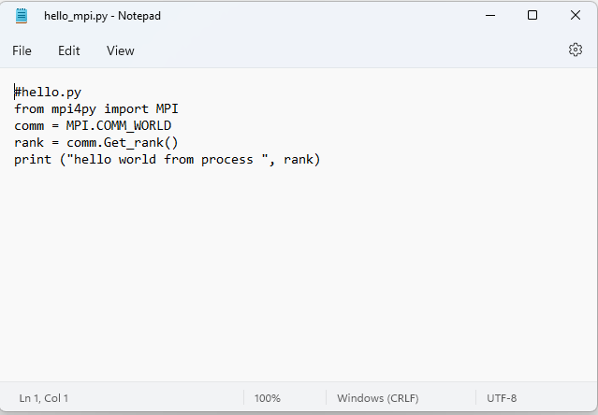
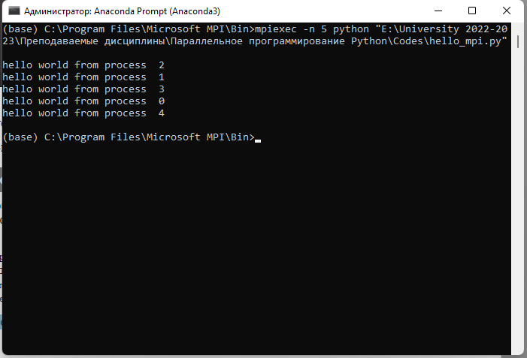
Starting the program

Slide 6
processes
In MPI, the processes involved in the execution of a parallel program are identified by a sequence of non-negative integers called ranks. If we have a number p of processes that runs a program, the processes will then have a rank that goes from 0 to p-1. The function MPI that comes to us to solve this problem has the following function calls:
rank = comm.Get_rank()
This function returns the rank of the process that called it. The comm argument is called a communicator, as it defines its own set of all processes that can communicate together, namely:
comm = MPI.COMM_WORLD

Slide 7
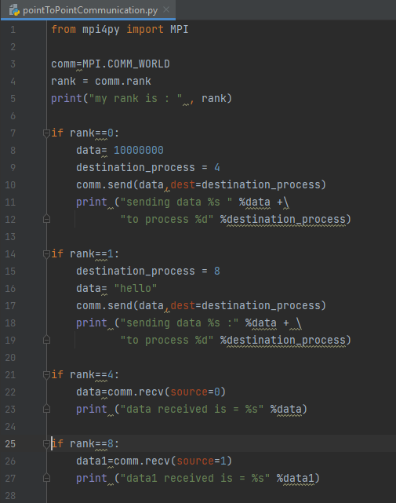
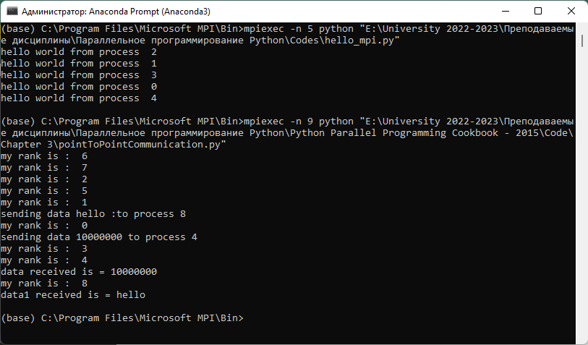
Process to process communication

Slide 8
Process to process communication
We ran the example with a total number of processes equal to nine. So in the communicator group, comm, we have nine tasks that can communicate with each other:
comm=MPI.COMM_WORLD
Also, to identify a task or processes inside the group, we use their rank value:
rank = comm.rank
We have two sender processes and two receiver processes.
The process of a rank equal to zero sends numerical data to the receiver process of a rank equal to four:
if rank==0:
  data= 10000000
  destination_process = 4
  comm.send(data,dest=destination_process)
Similarly, we must specify the receiver process of rank equal to four. Also, we note that the comm.recv statement must contain as an argument, the rank of the sender process:
…
if rank==4:
  data=comm.recv(source=0)

Slide 9
Process to process communication
For the other sender and receiver processes, the process of a rank equal to one and the process of a rank equal to eight, respectively, the situation is the same but the only difference is the type of data. In this case, for the sender process, we have a string that is to be sent:
if rank==1:
  destination_process = 8
  data= "hello"
  comm.send(data,dest=destination_process)
For the receiver process of a rank equal to eight, the rank of the sender process is pointed out:
if rank==8:
  data1=comm.recv(source=1)

Slide 10
Process to process communication
The following figure summarizes the point-to-point communication protocol in mpi4py:

